Slide 1
Kashmir commercials
Project progress report
By
Himayat Habib (Group Leader)
Sufaiya Rehman Under the Supervision of
Wasil Khursheed Dr . Umar Farooq
Tabish Handoo
MCA 4th Semester

Slide 2
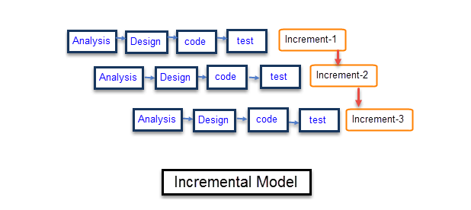
PROJECT PROGRESS SLIDE
Current
Stage 1
Stage 2
Stage 4
Stage 5
System Design
Development/ Implementation
Testing
Deployment & Maintenance
Stage 3

Slide 3
What is E-commerce website
An E-Commerce website is a platform that enables online transactions for the purchase and sale of tangible items, services and digital products as opposed to in-person transactions.
A company may manage shipping and logistics, process orders, receive payments and offer customer care through an E-Commerce website.

Slide 4
Kashmir commercials
The website aims to develop an online market over the internet.
It will be in the form of an E-Commerce portal which will allow seller to advertise and sell their products on the internet.
This would permit them to make their products available to users on a mass scale.
It will help people connect with one another for the purpose of trade and exchange of services.

Slide 5
Functional Requirement
It is the first of its kind in Kashmir.
Time Saving online marketing.
24/7 customer care.
Delivery time will be very less.
As it is specific for Kashmir we can provide counters in various districts.
Sometimes there is Internet Shortage in Kashmir Users can place order on phone call.
Their will be an image search option for less educated users.

Slide 6
How to build trust in people for using our website
We will provide an Open Ticket System for Suggestions/Complaints.
Other E-Commerce Sites are taking very much time for delivery, ours is particularly for Kashmir so delivery time will be reduced.
Admin has full access on website to filter spam sellers and spam users.
There will be various verification Mechanism.
We will use HTTPS, SSL Certificate for security purpose.

Slide 7
Technology used
Front-End (HTML, CSS, JAVASCRIPT).
Back-End (PHP).
Database (SQL).
Server (Apache).

Slide 8
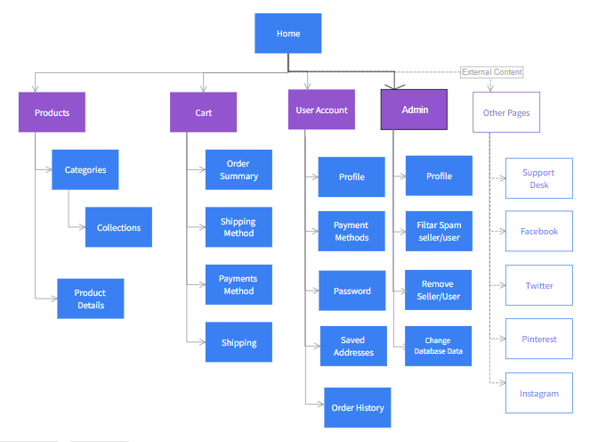
Site Map

Slide 9
Kashmir Commercials Pages
Admin Page.
User SignUp Page.
User SignIn Page.
Seller SignUp Page.
Seller SignIn Page.
Products Page.
User Cart Page.
Payment Page.

